Slide 1

EMPLOYEE PERFROMANCE EVALUATION
DATA ANALYSIS

Slide 2

DATA CHARACTERISTICS OBSERVED
No Null /Missing Values in the data.
Outliers- 5.5% of the rows (verified using z-score)
Significant Skewness and Kurtosis is observed in the data

Slide 3
MAJOR FINDINGS
Low Performance
Sales Department has the maximum no. of low performance employees.
Sales Executive Role has the lowest ratings.
High Performance
Development Department has maximum no. of high performing employees.
Developer Role has the highest ratings.

Slide 4
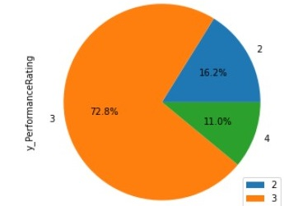
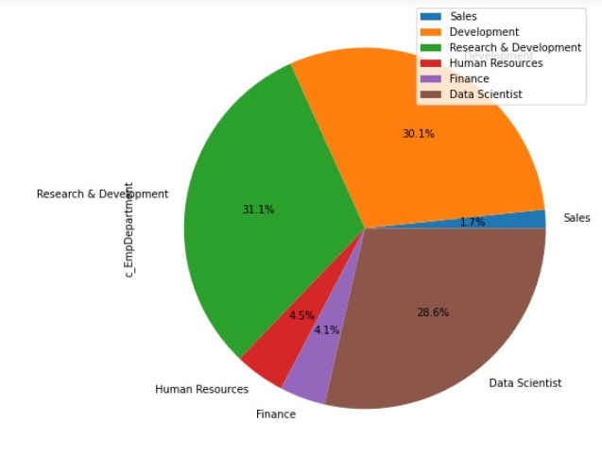
Performance Rating
Employee Department

Slide 5
NUMERICAL FEATURES IMPACTING PERFORMACE
BASED ON PEARSON CORRELATION COEFFICIENT
Significant Correlation exists between the following features:
YearsWithCurrentManager
YearsSinceLastPromotion
TotalWorkExperience
ExperienceInCurrentRole
ExperienceAtThisCompany
Very less Correlation seen with Performance Rating and other variables.

Slide 6
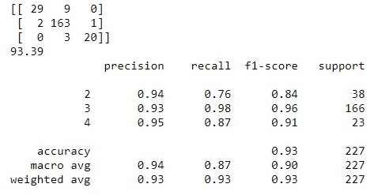
MODEL PERFORMANCE
XG Boost Classifier performed well and gives an accuracy of 93.39

Slide 7
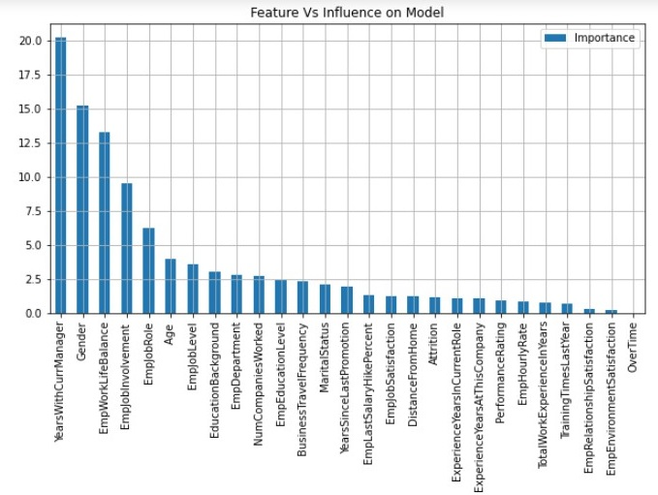
FEATURE IMPORTANCE
Top 3 feature affecting the Employee Performance:
YearWithCurrManager
Gender
EmpWorkLifeBalance

Slide 8
RECOMMENDATIONS
Development Department has standout performance so we can recommend Development Department based on their performance to improve more performance.
Sales Executive and Developer Employees have a better performance as compare to other employee so we want to recommend those employees which have a better performance.
In EducationBackground ‘Life Sciences’ educated people have better performance so we recommend only these people to improve employee performance.
BusinessTravelFrequency ‘Travel_Rarely’ employees have the best performance so we want to recommend the Travel_Rarely employees.
Further data to be collected on factors impacting Environment Satisfaction and Work Life Balance with people of Experience less than 3 years.

